Slide 1

NLP Natural Language Processing
Emotion Mining
P125 , Team - 2

Slide 2
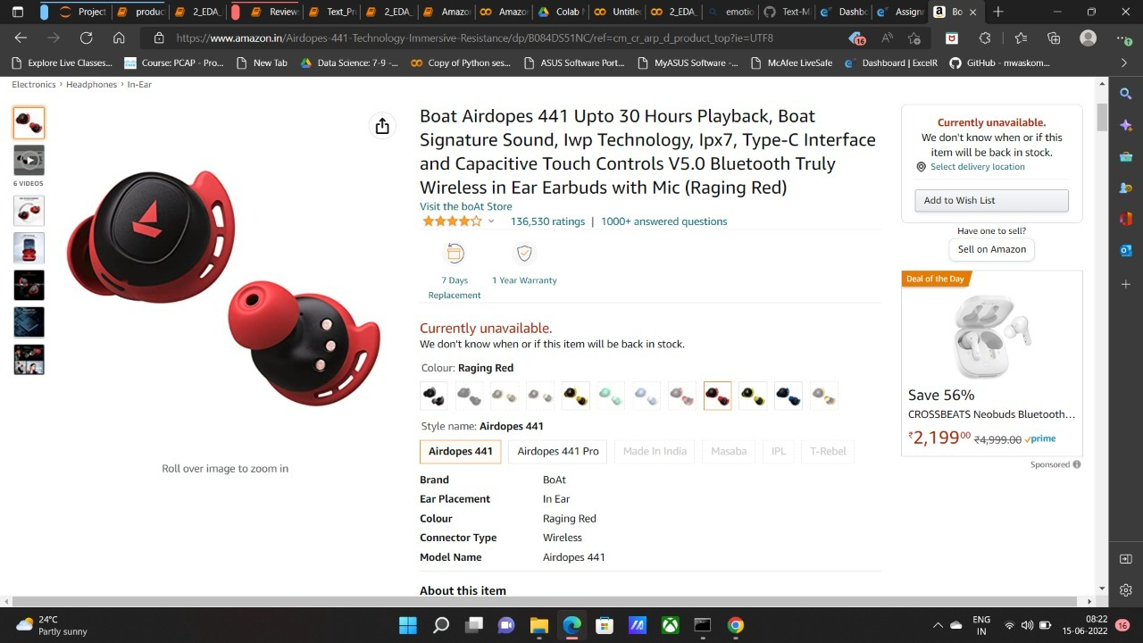

Extracting sentiment form customer reviews on a product.

Slide 3
Natural Language Processing-
NLP is a application of Artificial Intelligence of Computer Science.
It is a inter mediation between human language and machine language.
Text are unstructured data.
Extracting high quality information from text.
We do text optimization by removing unwanted word, symbols and lemmatize the text.
After optimize the text we go for NLP by converting text to number then model creation and prediction.

Slide 4
Emotion Mining-
A major task that the NLP (Natural Language Processing) has to follow is Sentiments analysis.
Emotion mining from text refers to the detection of people’s emotions based on observations of their writings.
For finding whether the user’s attitude is positive, neutral or negative, it captures each user’s opinion and feelings about the corresponding product.
Through this, needed changes can well be done on the product for better customer contentment by the companies.

Slide 5
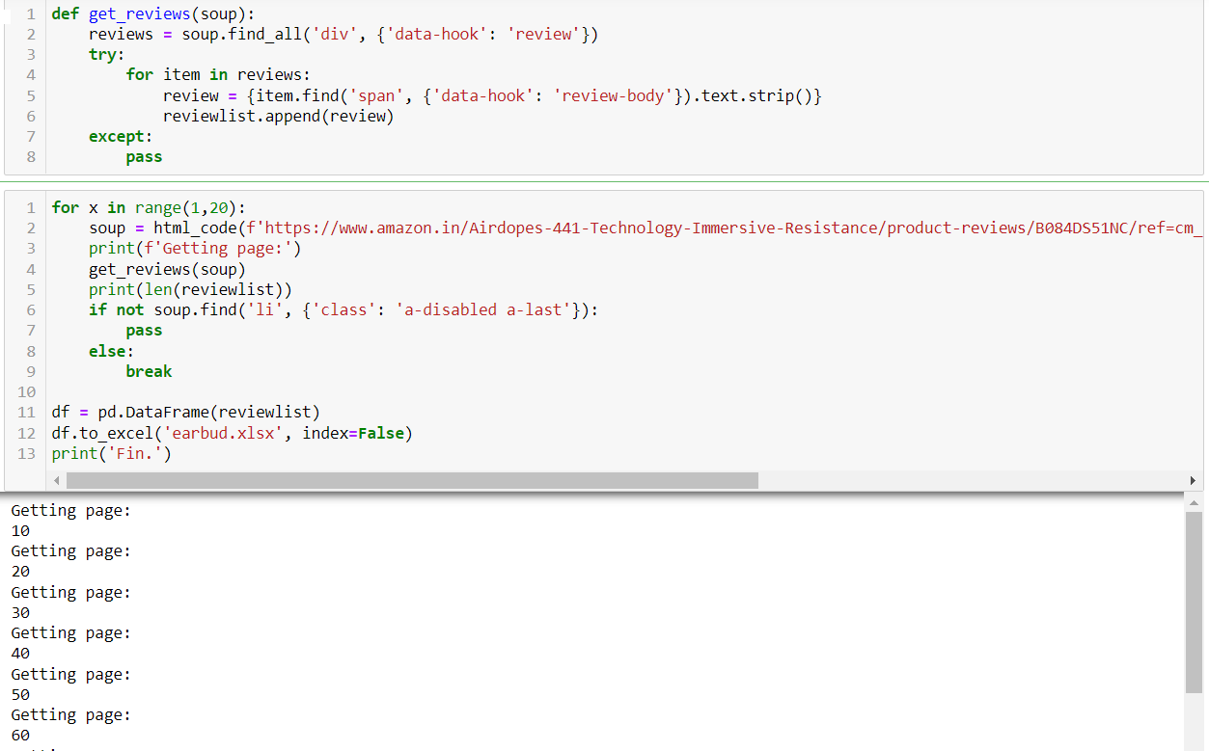
Amazon Review Web Scraping
Amazon review on boat ear dopes.
Scraping review from amazon website by using bs4 and request library.
Requests will allow you to send HTTP requests using Python.
!pip install requests
import requests
Beautiful Soup is a Python library that is used for web scraping purposes to pull the data out of HTML and XML files.
It creates a parse tree from page source code that can be used to extract data in a hierarchical and more readable manner.
!pip install bs4
from bs4 import BeautifulSoup

Slide 6
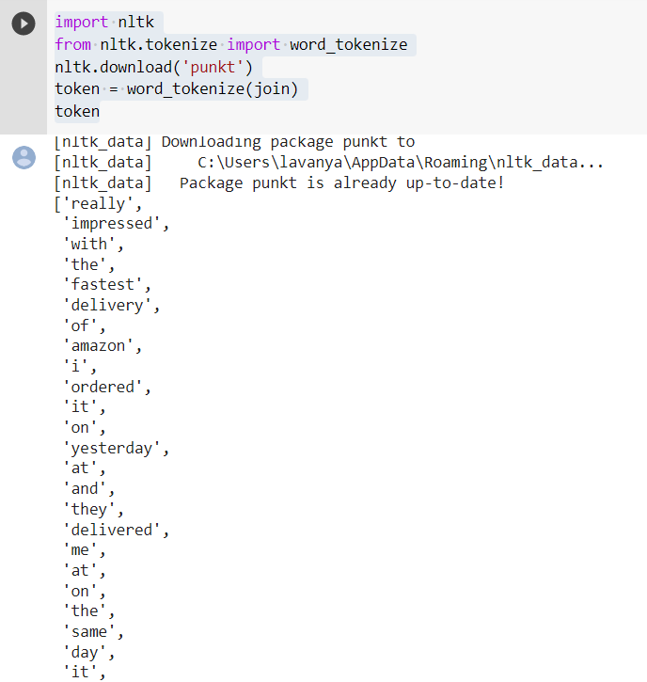
EDA-
We check for null value and duplicate data in the review file.
We apply tokenization, normalisation, lemmatisation and transform text into Data Structure.
Tokenization-
We split the sentences or document into chunks into meaningful words.
It generally comprise word and number but we can include punctuation mark, symbols etc.

Slide 7
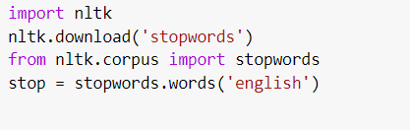
Normalisation-
Transform various form of same word into a common form.
We remove all the punctuation marks, special character and unwanted characters, extra spaces etc.
Transform all words to lower case .
Ex-HAPPY, Happy, happY = happy
Stop word-
Stop word have no significant importance or they carry very little useful information on the natural data so we remove the stop word.
Ex- ‘a’, ‘the’, ‘is’, ‘are’ etc
We remove ‘no’ and ‘not’ from stopword as they might change the meaning of some review.
Stemming and Lemmatization-
Stemming and lemmatization are methods used by search engines and chat bots to analyze the meaning behind a word.
Stemming uses the stem of the word.
Algorithms work by cutting off the end or the beginning of the word, taking into account a list of common prefixes and suffixes that can be found in an inflected word. Stemmed word might have or don’t have proper meaning.
Ex- run – run , running –run, ran –ran, runs – run, easily – easili , fairly – fairli

Slide 8
Lemmatization-
Lemmatization uses the context in which the word is being used.
It consideration the morphological analysis of the words. To do so, it is necessary to have detailed dictionaries which the algorithm can look through to link the form back to its lemma.
Ex-saw VERB see eighteen NUM eighteen mice NOUN mouse today NOUN today

Slide 9
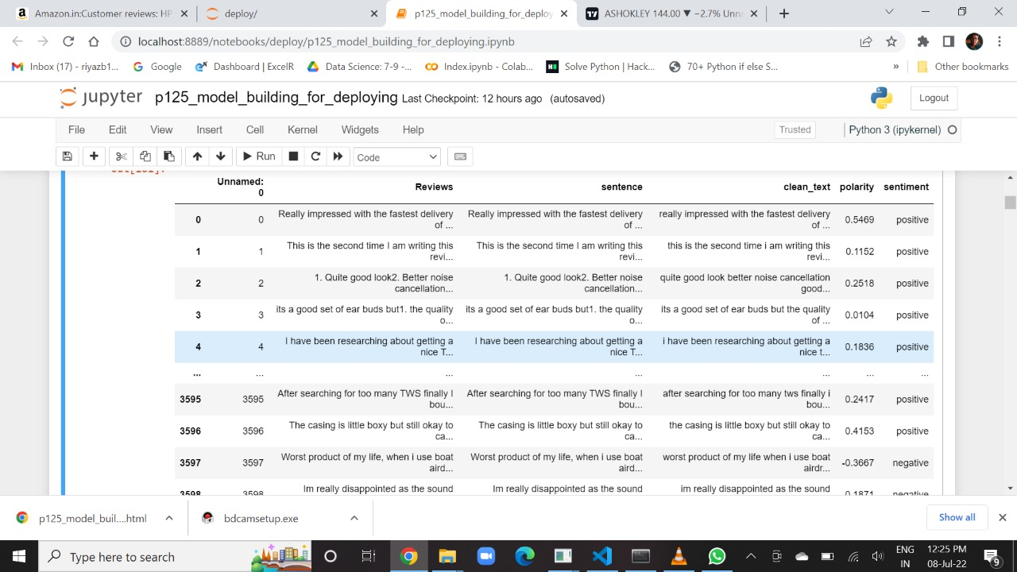
Dataset-

Slide 10
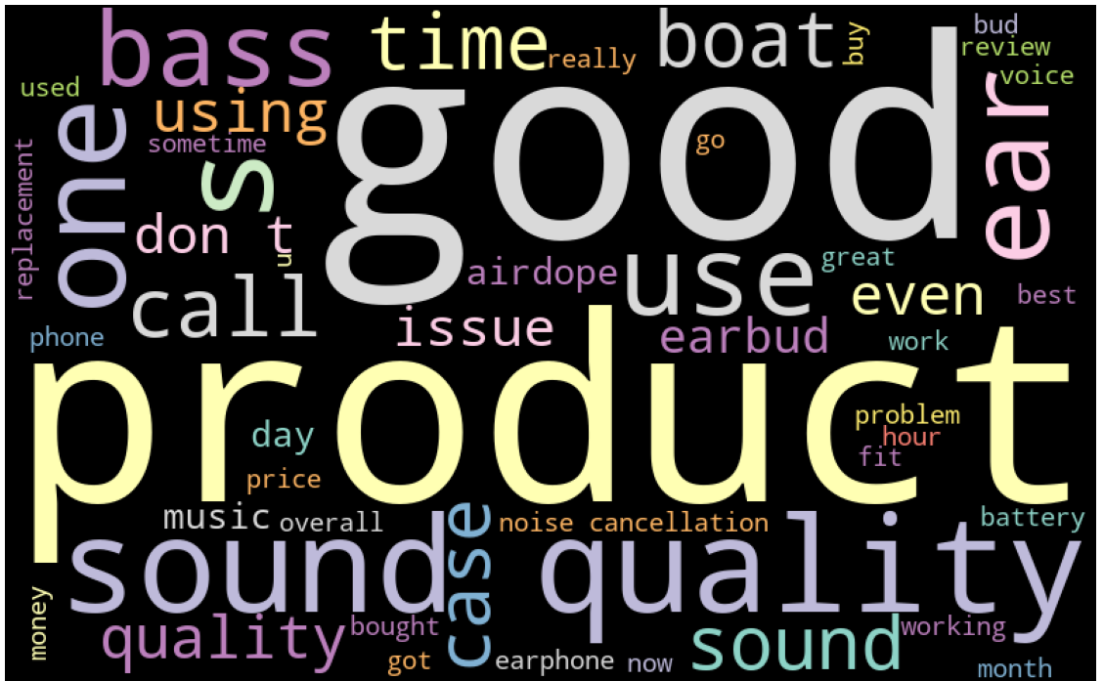
WordCloud-
We use wordcloud to get frequency of words in the document.
from wordcloud import WordCloud
We use matplot library to visualise the word, word size will be shown by the frequency.
import matplotlib.pyplot as plt
%matplotlib inline

Slide 11
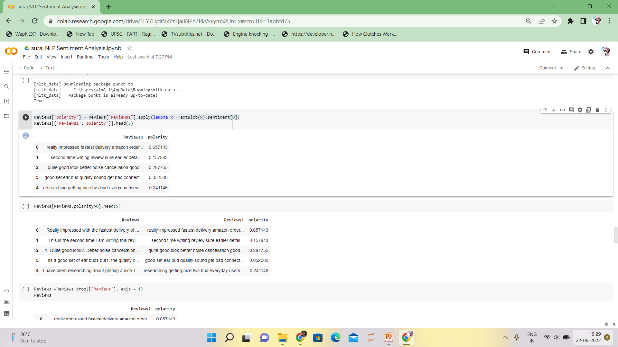
Sentimental Score-
It is a scaling system that reflects the emotional depth of emotions in a piece of text via numbers.
We have use following libraries for sentimental score-
Affin
Textlob
Vader
Textlob-
Textlob return polarity value between -1.0 to 1.0 in float, where 0 is nutral
from textblob import TextBlob
from textblob import Word

Slide 12
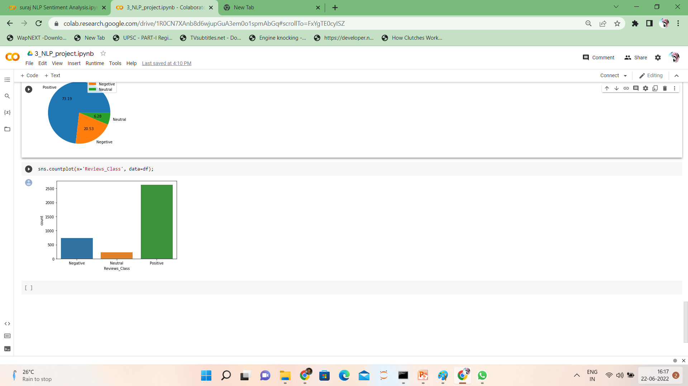
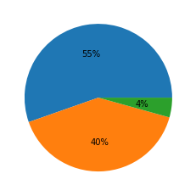
plt.pie(df['Reviews_Class'].value_counts(), labels=('Positive','Negetive','Neutral'),autopct='%.2f')
plt.legend();
-Positive -Negative -Neutral

Slide 13
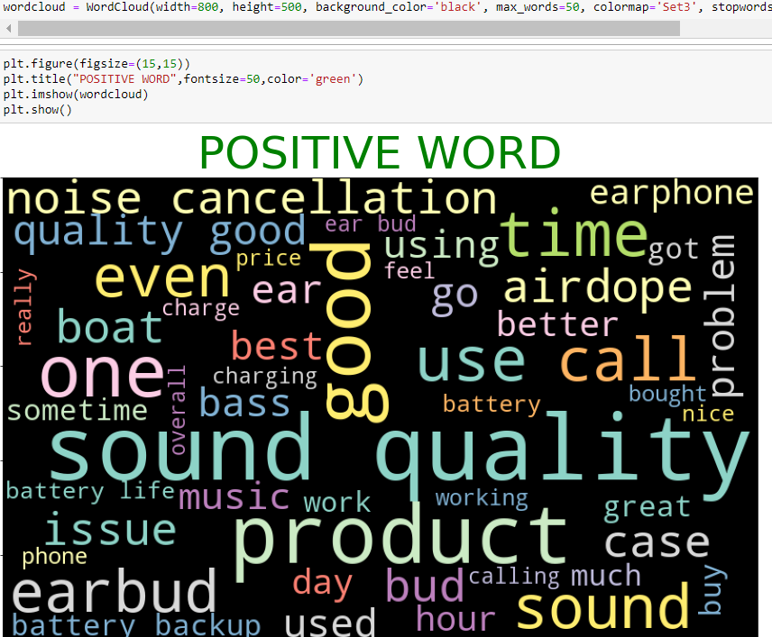
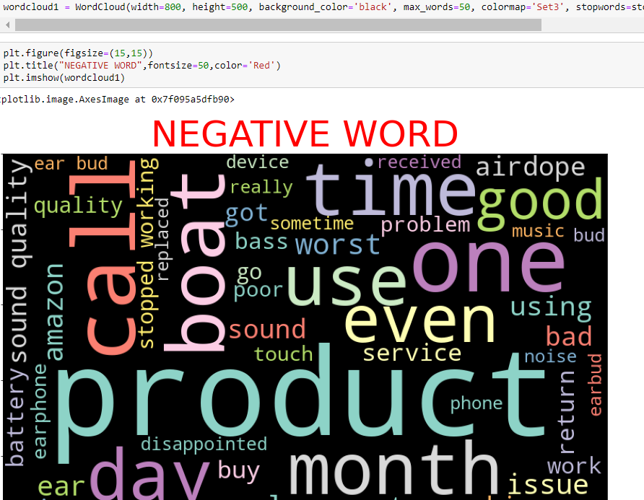
Negative word-
Positive word -

Slide 14
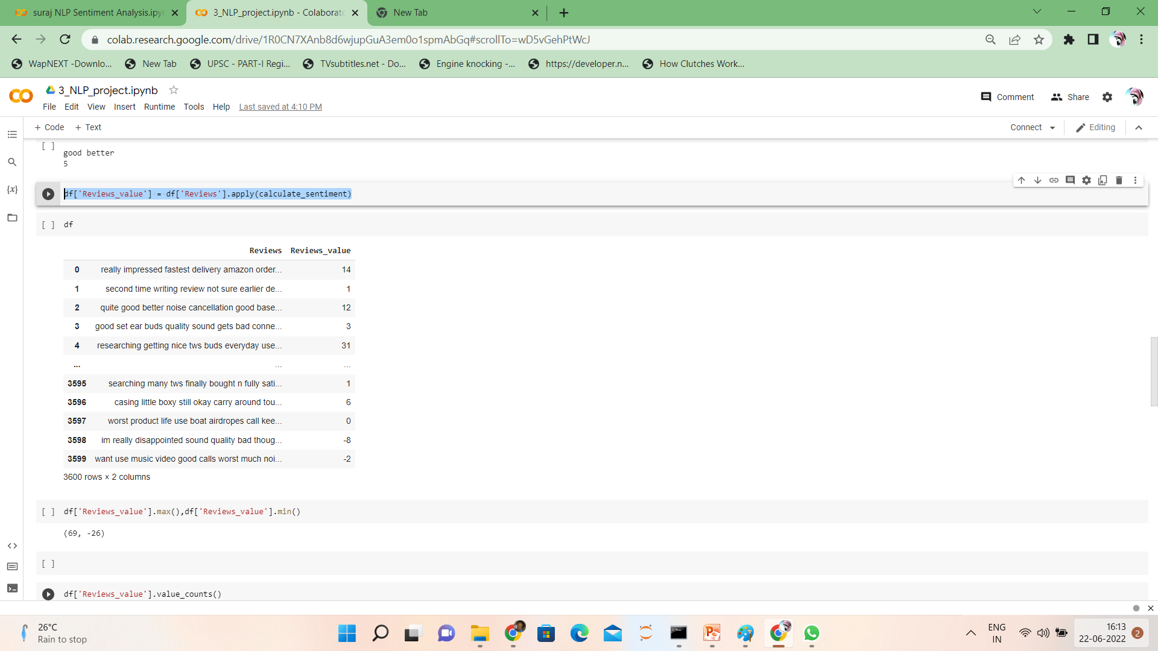
Features and Target –
Here the features is the review column which we have convert to numeric format by using Tfidf fit_transform .
Target is the sentiment column.

Slide 15
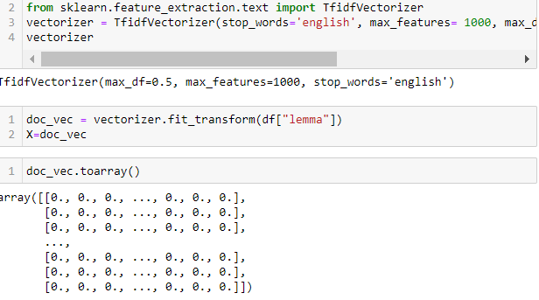
TFIDF-
Term frequency Inverse document frequency.
We TFIDF to get words weightage and frequency on a given document.
We can select max feature s and the max frequency from the document.

Slide 16
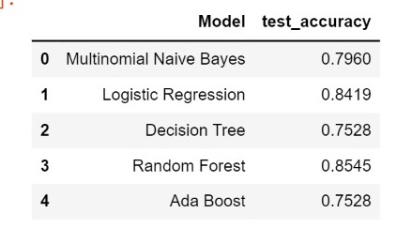
Model-
In NLP we create models using various supervised method-
MultinomialNB
Random forest
Decision tree classifier
SVC
Logistic Regression
From the above model we did train test split of 75:25, and calculate the accuracy, confusion matrix.

Slide 17
Model Selection-
We got best fit for data in MultinomialNB from the rest .
Got the accuracy approx. 80%
Then we decided to go with MultinomialNB model

Slide 18
Created user define function to check whether model is predicting output properly or not
Then imported pickle library to dump vectorizer and model (MultinomialNB) file
Then created pipeline to deploy code to check product review
In pipeline we have added two pickle file viz vectorizer and model file and then added punctuation, stemming, TextBlob lexicon Library code.

Slide 19
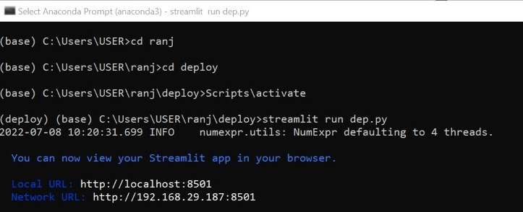
Model Deployment-
After creation of pipeline we open Anaconda command prompt
Then entered required command to deploy our model

Slide 20
Model Deployment-
In Anaconda prompt we downloaded streamlit
Then open Visual Studio Code (vs code), save the pipeline file
Now run the code in anaconda prompt or vs code
streamlit run dep.py (here .py is python file and dep could be any name)
After execution of code it will take you to browser
Now enter the review and get the result of sentiment and polarity.

Slide 21
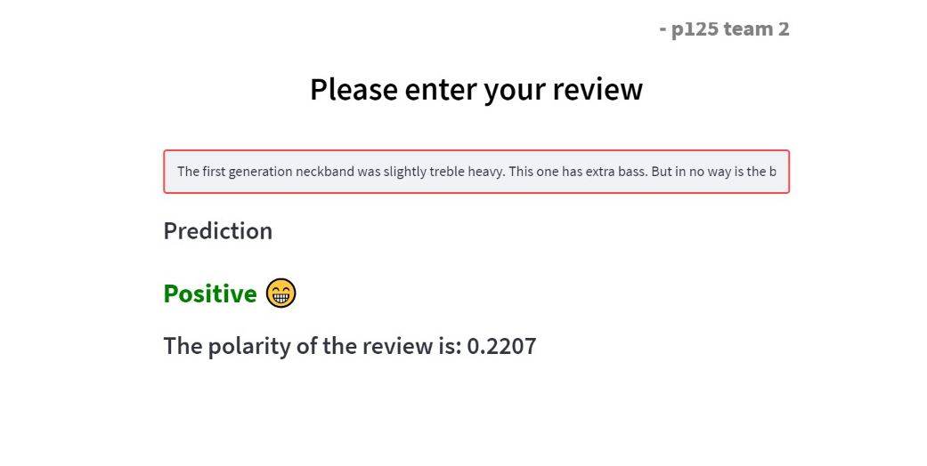
Conclusion-
Now we have a clean data which can be use for worldcloud, Emotion analysis, Positive, negative, neutral statement, model creation for training and testing data.

Slide 22


